Slide 1
Personal Loan approval using ml

Slide 2
Agenda
Introduction
Working
Model

Slide 3
working

Slide 4
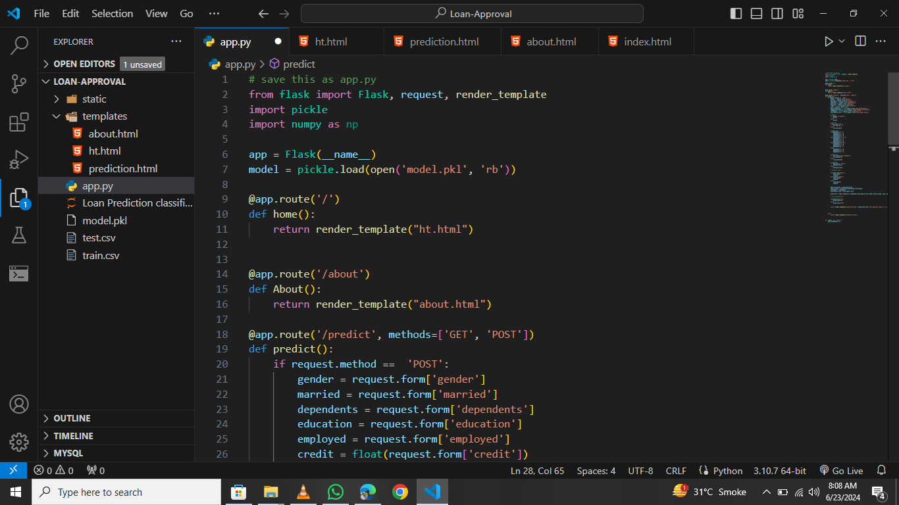
Install Flask , numpy and other required libraries and Run the app.py

Slide 5
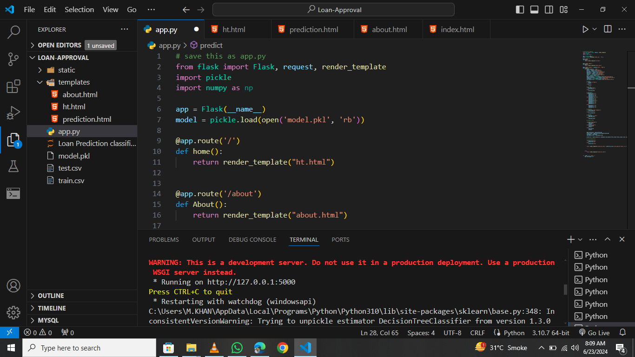
Click on the link in terminal

Slide 6
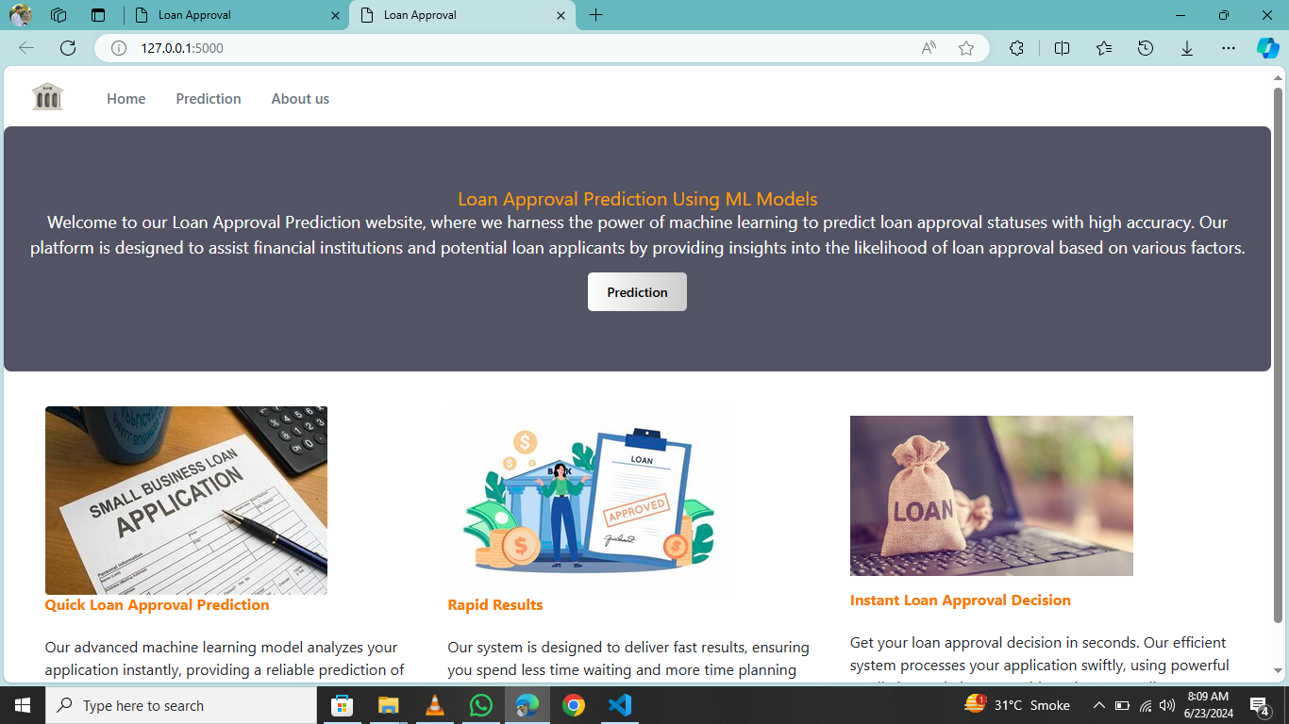
This is main page that has information
About the model and links for other pages
Button for prediction page

Slide 7
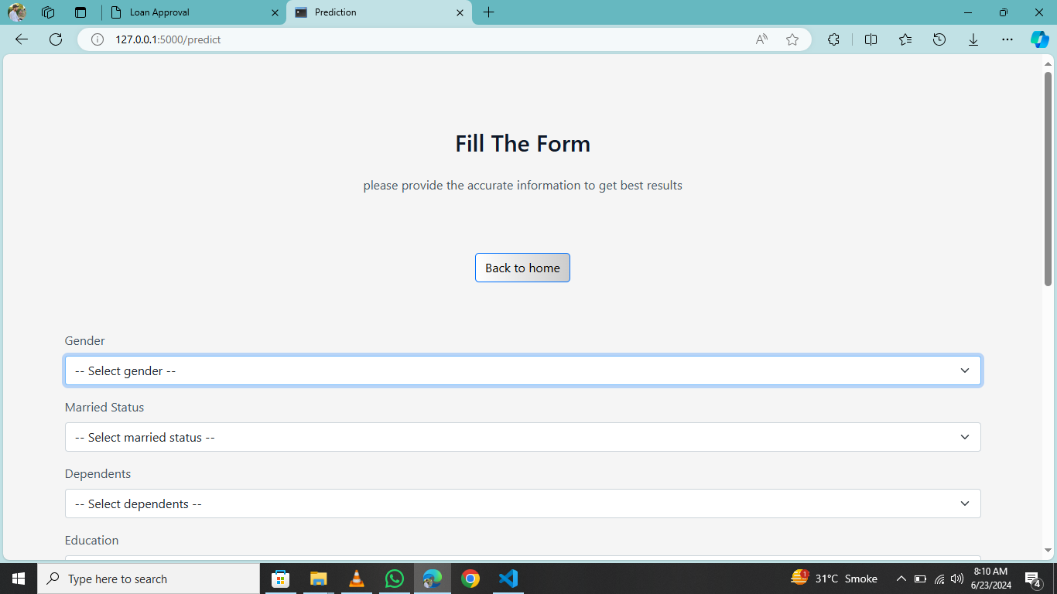
Fill up the page to get the prediction
Using the model trained saved in “model.pkl” file.

Slide 8
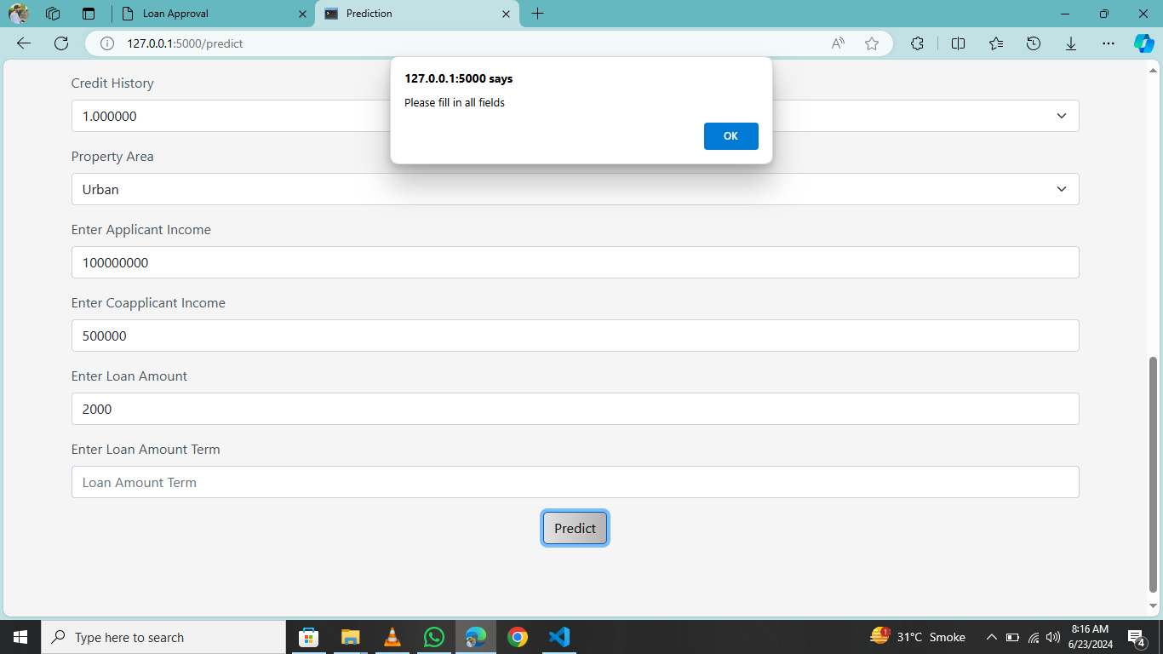
If fields are missing, pop up
message will be shown

Slide 9
Model

Slide 10
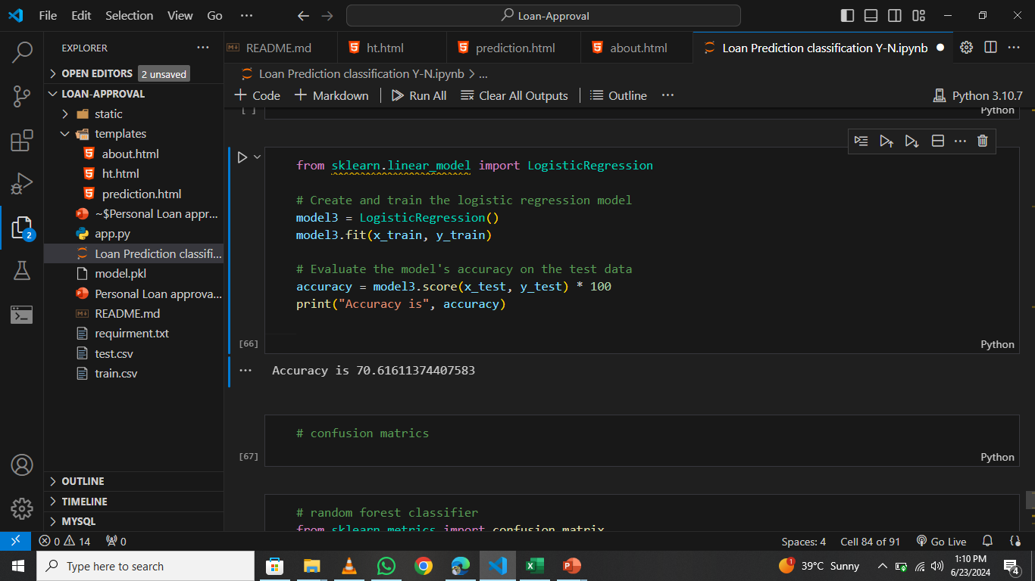
Logistic Regression gives accuracy
of 70.61

Slide 11
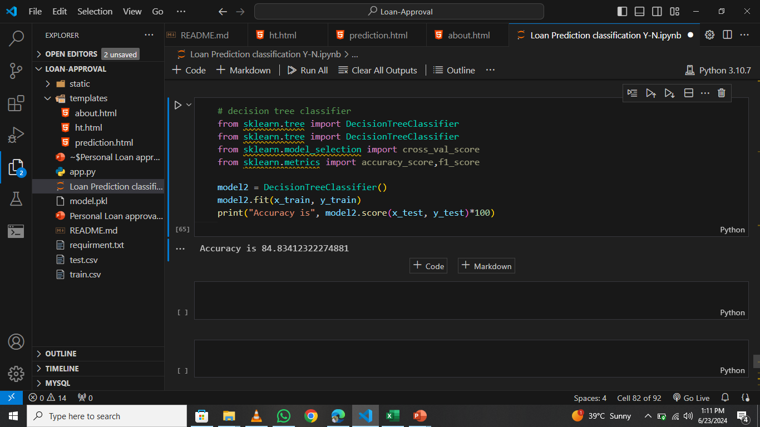
Decision Tree classifier
gives accuracy of 84.83

Slide 12
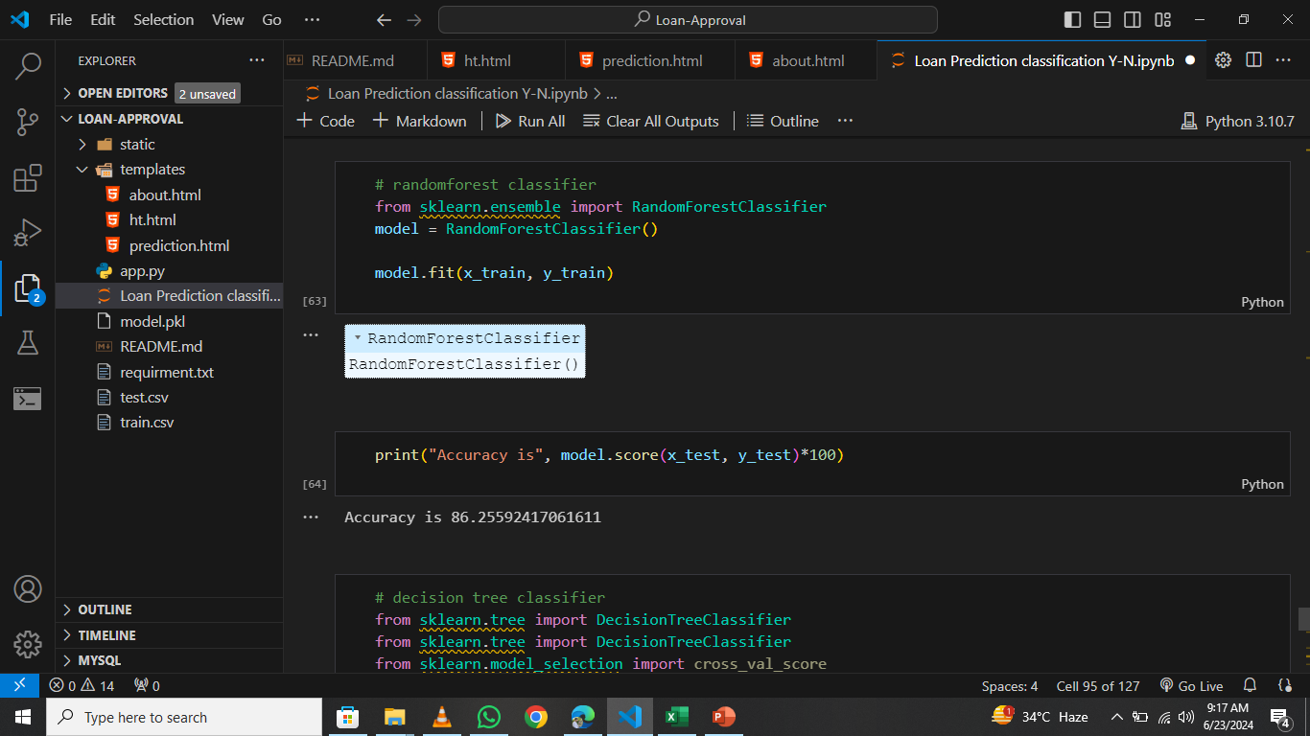
Random forest classifier is used
It gives best accuracy of 86.25
among all models

Slide 13
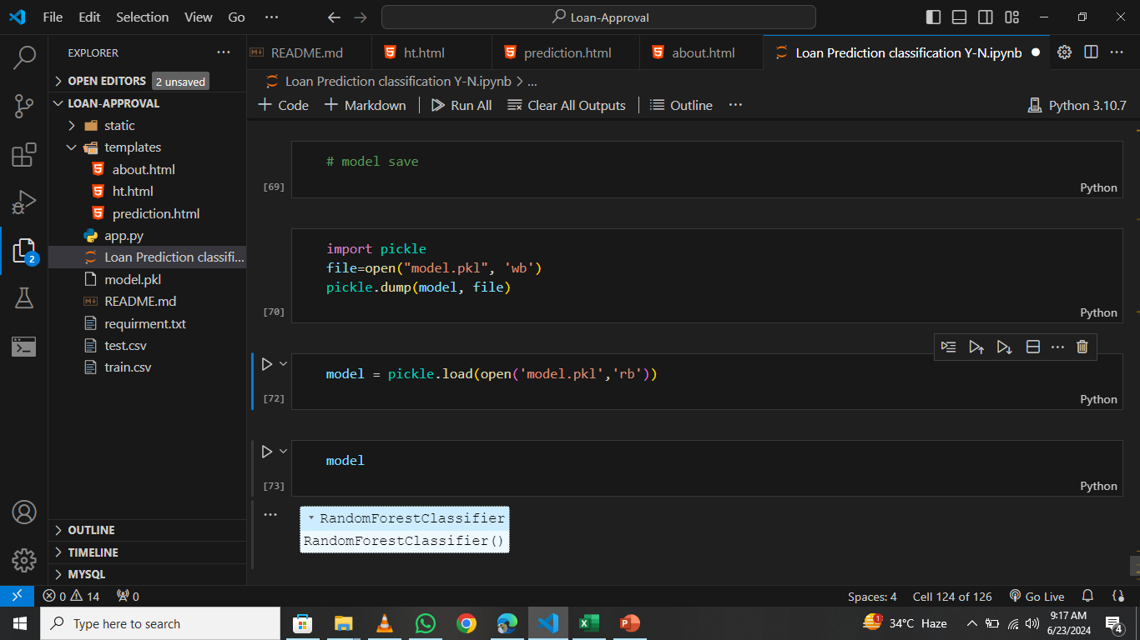
Model is saved in a pickle file and
Imported in app.py for applying
On user’s input

Slide 14
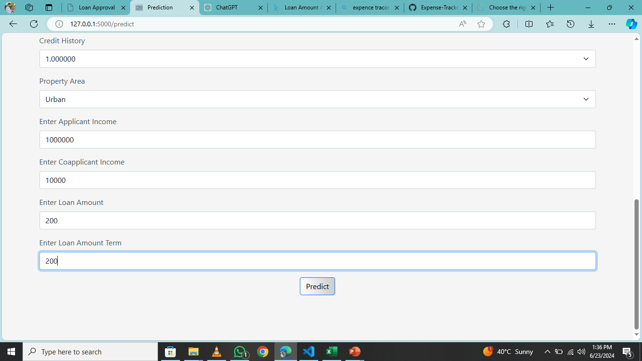
After entering the details
Click on the predict button

Slide 15
The model is being imported
Here in app.py

Slide 16
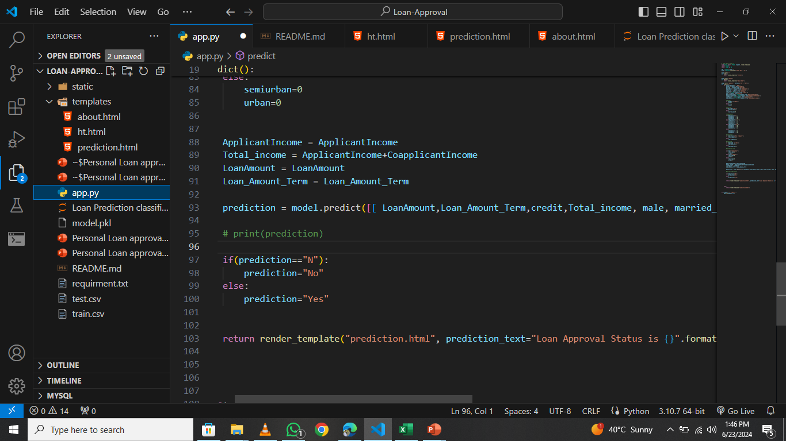
Model is being used here to
Predicted result according to
input

Slide 17
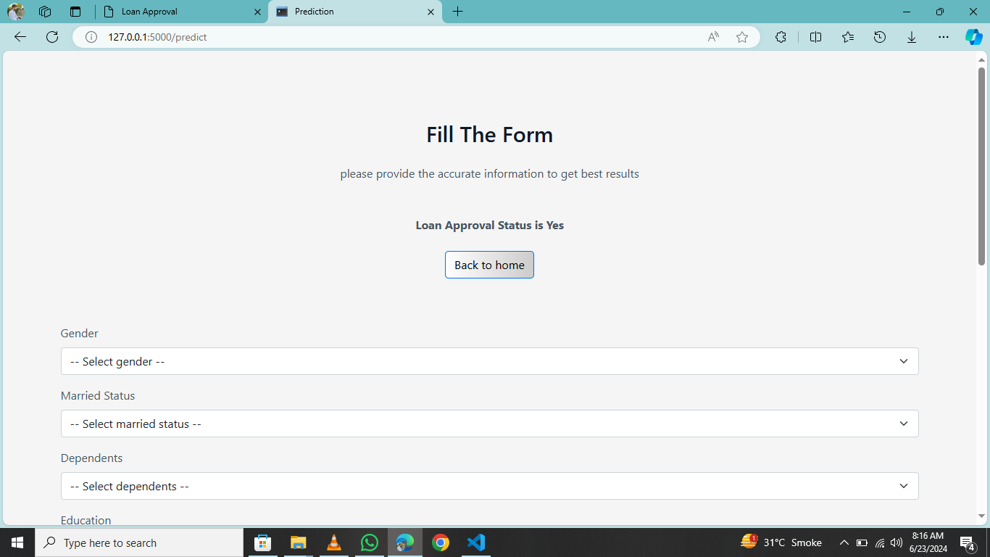
After giving inputs the result is
shown above the prediction page

Slide 18
